Slide 1
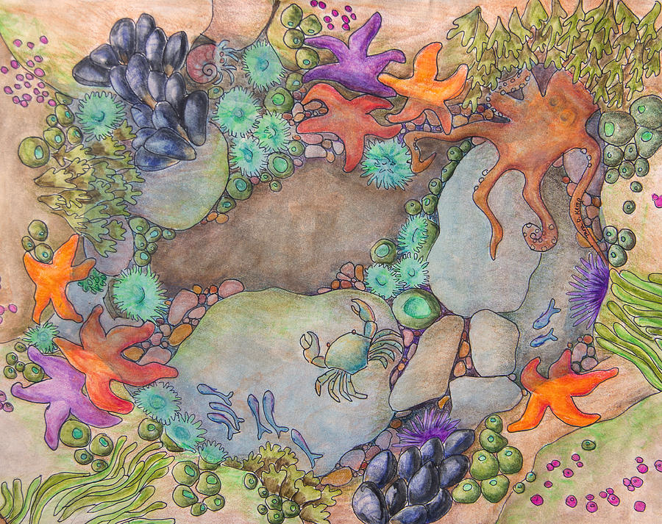
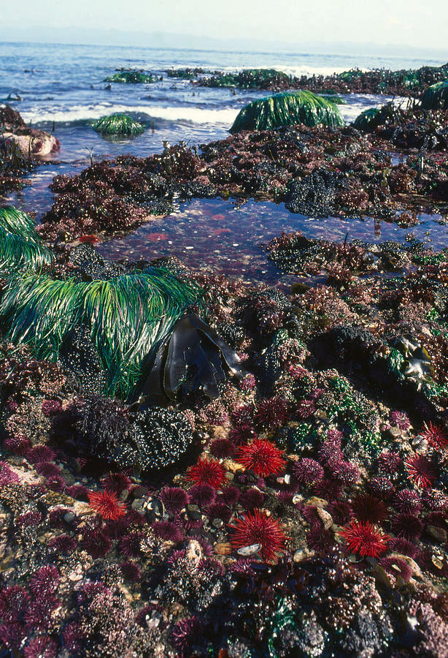
Session 3:
Tide pool biodiversity
(Activities for 5th+ grade students)
Created by:
Brittany Bennett
Holland Elder
JL Weissman
Jesse McNichol
Nicole Ratib
Suzana Leles
Trang Nguyen

Slide 2
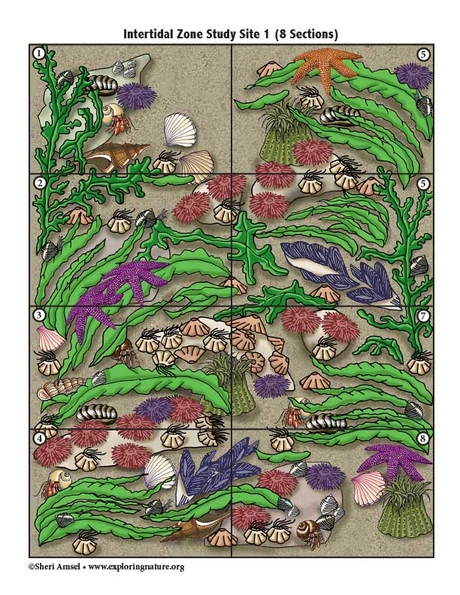
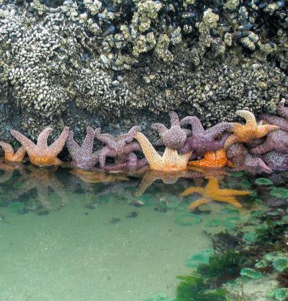

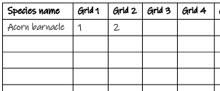
Activity 1: Evaluate tide pool biodiversity
Food for thought:
1. Have you ever been to a marine tide pool before?
2. Can you guess how many types of living creatures you can find at a tide pool?
3. Do you know how scientists study the biodiversity of the tide pool?
What you will need:
1 ruler
1 pencil
A tide pool organism key
A worksheet (next page)
2 images of 2 study sites
Step 1:
Start with Study Site A. Use the tide pool organism key to identify the organisms and count the number of each organism you see. Fill in the numbers!
Step 2:
Draw the transect sampling lines to split Study Site B into 6 small equal-size grids (3 rows x 2 columns). Number each grid from 1 to 6
1
4
2
5
3
6
Step 3:
Identify, Count and Fill in the number of organisms you see in Study Site B to the worksheet
Let’s discuss
1. Which study site has more types of organisms?
2. Which study site has more total organisms (including organisms of the same type)?
3. As a result, which study site is more diverse?
Add your final answers here (after filling the 2 worksheets)

Slide 3
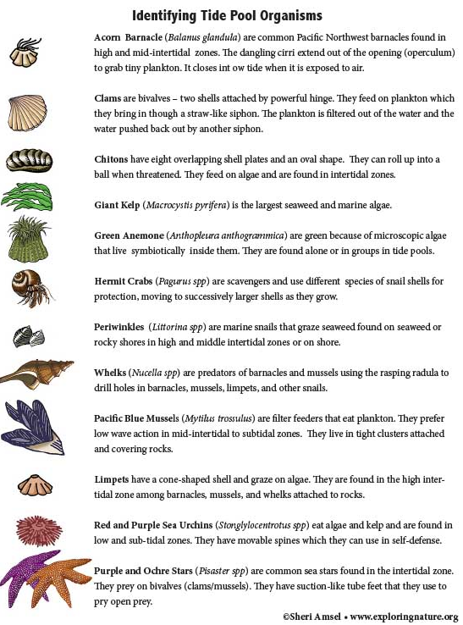
Activity 1: Evaluate tide pool biodiversity

Slide 4
Activity 1: Evaluate tide pool biodiversity
Study Site A

Slide 5
Activity 1: Evaluate tide pool biodiversity
Worksheet for Study Site A
List the name of all the organisms that you see in Study Site A in the first column
Fill in the number of each organism that you see in each Grid
Species name | Grid 1 | Grid 2 | Grid 3 | Grid 4 | Grid 5 | Grid 6 | Grid 7 | Grid 8
Acorn barnacle | 1 | 2
N1= Total # of organisms
N2= Total # of organism types
Diversity index =N2/N1
Biodiversity (Lo, Med, Hi)
3. Per Study Site A (combination of all 8 grids):
N1 = …………… N2 = ……………. Diversity index = …………….. Biodiversity: …………………………………

Slide 6
Activity 1: Evaluate tide pool biodiversity
Study Site B

Slide 7
Activity 1: Evaluate tide pool biodiversity
Worksheet for Study Site B
List the name of all the organisms that you see in Study Site B in the first column
Fill in the number of each organism that you see in each Grid
Species name | Grid 1 | Grid 2 | Grid 3 | Grid 4 | Grid 5 | Grid 6
N1= Total # of organisms
N2= Total # of organism types
Diversity index =N2/N1
Biodiversity (Lo, Med, Hi)
3. Per Study Site B (combination of all 6 grids):
N1 = …………… N2 = ……………. Diversity index = …………….. Biodiversity: …………………………………

Slide 8
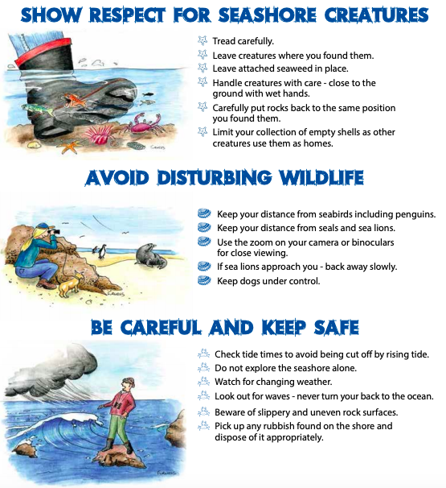
Activity 2: Human impacts on the tide pool diversity
Food for thought:
As beach-goers, what you wish to do to protect the tidal habitat?
As a fisherman, what can you do to protect the tide pool organisms?
As city leader, what can you do to protect the beach and tide pool?
What you will need:
1 pencil
A worksheet (next page)
Step 1:
Let’s divide into 3 groups to represent different groups of people to discuss our environmental action!
Group 1: Beach-goers
Group 2: Fishermen
Group 3: City leaders
Step 2:
Among your group, let’s discuss in 25 minutes the following questions for the tide pool in Southern California coast.
What is the issue?
What is the goal of your group?
What skills will we need?
Who could influence the decision?
What are the actions?
How will we find out what people think and feel about the issue?
How can we make people more aware of the issue?
What information do we need and where we will find it?
Let’s share the action sheet from your group to the class!

Slide 9
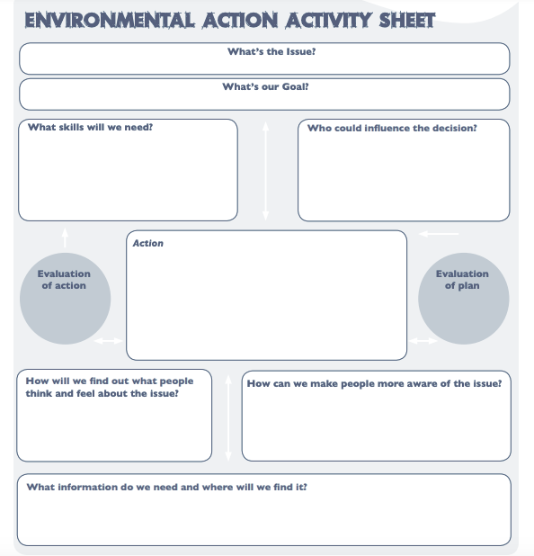
Activity 2: Human impacts on the tide pool diversity
Group that you belong: Beach-goers Fishermen City leaders
(draw a circle)

